Slide 1
CY - 5

Slide 2
Listing 1-13. An Alternative BankAccount Class
public class BankAccount {
public int acctnum;
public int balance = 0;
public boolean isforeign = false;
public BankAccount(int a) {
acctnum = a;
}
}
public int getBalance() {
return (int) balance;
}
public BankAccount(int a) {
acctnum = a;
}
}

Slide 3
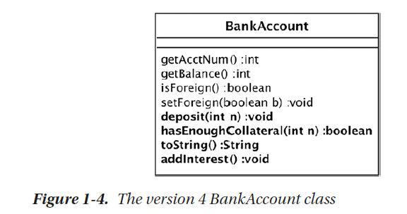

Slide 4
Listing 1-14. The Version 4 Bank Class
public class Bank {
...
public void deposit(int acctnum, int amt) {
BankAccount ba = accounts.get(acctnum);
ba.deposit(amt);
}
public boolean authorizeLoan(int acctnum,
int loanamt) {
BankAccount ba = accounts.get(acctnum);
return ba.hasEnoughCollateral(loanamt);
}
public String toString() {
String result = "The bank has " + accounts.size()
+ " accounts.";
for (BankAccount ba : accounts.values())
result += "\n\t" + ba.toString();
return result;
}
public void addInterest() {
for (BankAccount ba : accounts.values())
ba.addInterest();
}
}

Slide 5
Listing 1-14. The Version 4 Bank Class
public class Bank {
...
public void deposit(int acctnum, int amt) {
BankAccount ba = accounts.get(acctnum);
ba.deposit(amt);
}
public boolean authorizeLoan(int acctnum,
int loanamt) {
BankAccount ba = accounts.get(acctnum);
return ba.hasEnoughCollateral(loanamt);
}
public String toString() {
String result = "The bank has " + accounts.size()
+ " accounts.";
for (BankAccount ba : accounts.values())
result += "\n\t" + ba.toString();
return result;
}
public void addInterest() {
for (BankAccount ba : accounts.values())
ba.addInterest();
}
}

Slide 6
Listing 1-15. The Version 4 BankAccount Class
public class BankAccount {
private double rate = 0.01;
...
public void deposit(int amt) {
balance += amt;
}
public boolean hasEnoughCollateral(int amt) {
return balance >= amt / 2;
}
public String toString() {
return "Bank account " + acctnum + ": balance="
+ balance + ", is "
+ (isforeign ? "foreign" : "domestic");
}
public void addInterest() {
balance += (int) (balance * rate);
}
}

